Slide 1
Educational Analysis
Alirio Pena
TripleTen

Slide 2
Overview
This report analyzes Zomato’s food delivery sales to identify trends, seasonal patterns, and how customer demographics, especially education level, influence spending. The goal is to provide insights to improve restaurant partnerships, marketing, and customer engagement, and derive ideas for new promotional plans
Key Focus Areas:
Revenue trends over time (monthly & seasonal patterns).
Key performance indicators (KPIs): order volume, revenue per order.
Impact of education level on spending and order frequency.
Best-performing food categories across seasons.
Fast food's popularity across different education and income levels.
Comparing high-volume vs. high-revenue cuisines

Slide 3
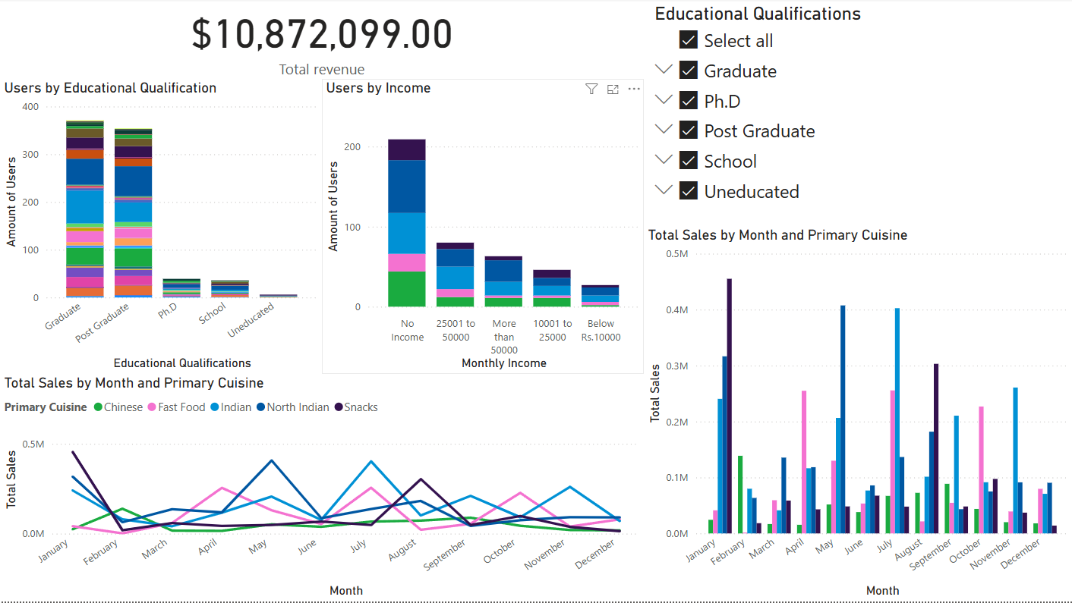

Slide 4
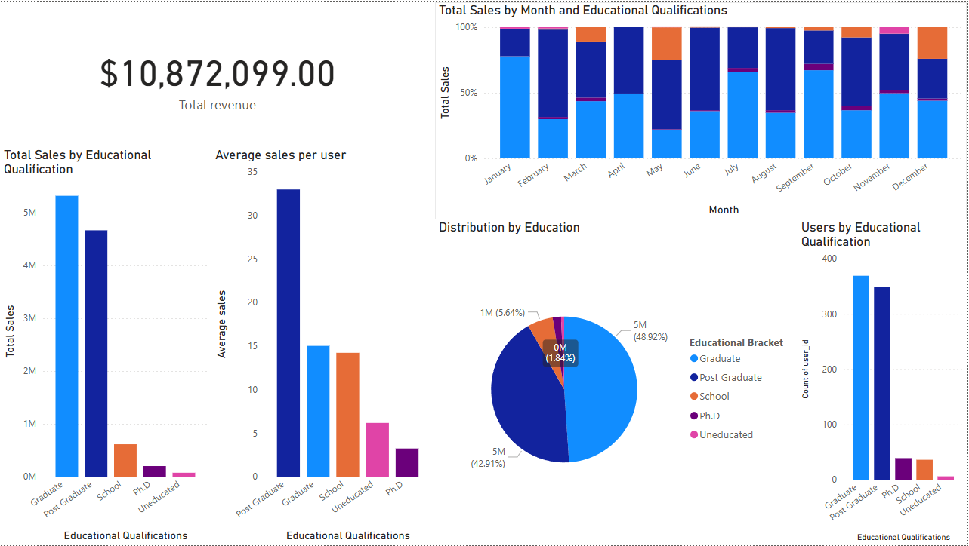

Slide 5
Findings
Its noted that Graduate and post graduate users make up around 90% of the sales on Zomato
Indian and North Indian food actually takes over a majority of sales overall across all brackets
It can be seen that those with higher income order in smaller and selective dining areas that do not make up the top 5 in sales on Zomato
Graduate and post graduate users make up $9,984,791.00 of all revenue confirming the notion that they will in in exotic and more niche restaurants
Fast food does perform adequately like Indian food though
Post grad and grad users do not even exist in fast food areas
A deeper analysis in foreign restaurants may reveal the majority of post graduate and graduate students
January, and July see peak in sales a look into how the app performs in the months will reveal how certain holidays within those days will affect revenue

Slide 6
Recommendations
Promotions with foreign restaurants to increase sale swith graduate and post graduate users will drive sales
A promotional offer for students to increase availability that mirrors student passes in America for Uber eats could lead to more account creation which could lead them to be long term customers.
Promotional pricing during low sales periods to increase sales for the mass revenue gaining cuisines
When using the app enable combo suggestions for the user

